Slide 1
The project has received funding from the LIFE Programme of the European Union under GA number LIFE19 ENV/GR/000100
Process Equipment Design Laboratory AUTh
Energy efficiency of Demo Houses and Naval Academy: Simulation Results
Prof. Agis Papadopoulos
Dr. Effrosyni Giama
On behalf of PEDL RESEARCH TEAM
fgiama@auth.gr

Slide 2
The project has received funding from the LIFE Programme of the European Union under GA number LIFE19 ENV/GR/000100
The European Green Deal
Strong linkage between energy and environmental policies
The EU should be climate neutral by 2050
Reaching this target will require action by all sectors of our economy, including
• investing in environmentally-friendly technologies
• supporting industry to innovate
• rolling out cleaner, cheaper and healthier forms of private
and public transport
• decarbonising the energy sector
• ensuring buildings are more energy efficient
• working with international partners to improve global
environmental standards
LIFE VISIONS

Slide 3
The project has received funding from the LIFE Programme of the European Union under GA number LIFE19 ENV/GR/000100
Key pillars in EU Energy Policy for Buildings
Energy Efficiency
Renewable Energy
Energy Performance
Decarbonisation

Slide 4
Methodology in brief
The project has received funding from the LIFE Programme of the European Union under GA number LIFE19 ENV/GR/000100
LIFEVISIONS
Measurements – Simulations in Demo Houses and in real scale application in Naval Academy
Simulations with DesignBuilder and Contam
Energy consumption
CO₂ emissions
Thermal comfort
The target was to identify the correlation of ventilation rates and photocatalysis (ventilation is related to energy consumption).
Indirect reduction of energy consumption because of the ventilation rate reduction.
LIFE VISIONS

Slide 5
Indoor conditions measurement equipment
The project has received funding from the LIFE Programme of the European Union under GA number LIFE19 ENV/GR/000100
LIFEVISIONS
System | Measurements | Measurement equipment
DEMO HOUSES | Air temperature | Comfort and air quality conditions using testo 480 and the necessary sensor probes (temperature, radiant temperature, relative humidity, CO2, air velocity, pmv/ppd) HOBO MX1102 (temperature, relative humidity, CO2). The installation and methodology is based on the international standards ISO 7726:1998 and ASHRAE 55
 | Relative Humidity
 | Air velocity
 | Radiant temperature
 | PMV/PPD
 | CO₂
LIFE VISIONS

Slide 6
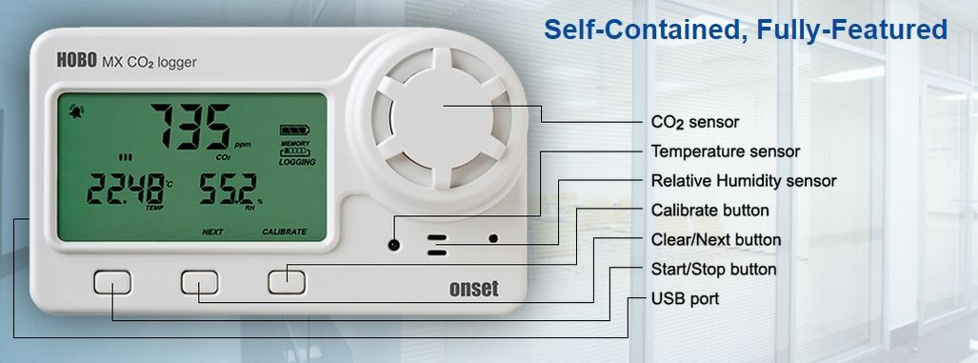
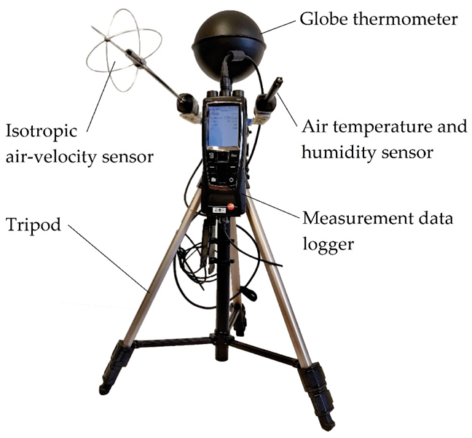
Indoor conditions data loggers
The project has received funding from the LIFE Programme of the European Union under GA number LIFE19 ENV/GR/000100
LIFEVISIONS
LIFE VISIONS

Slide 7
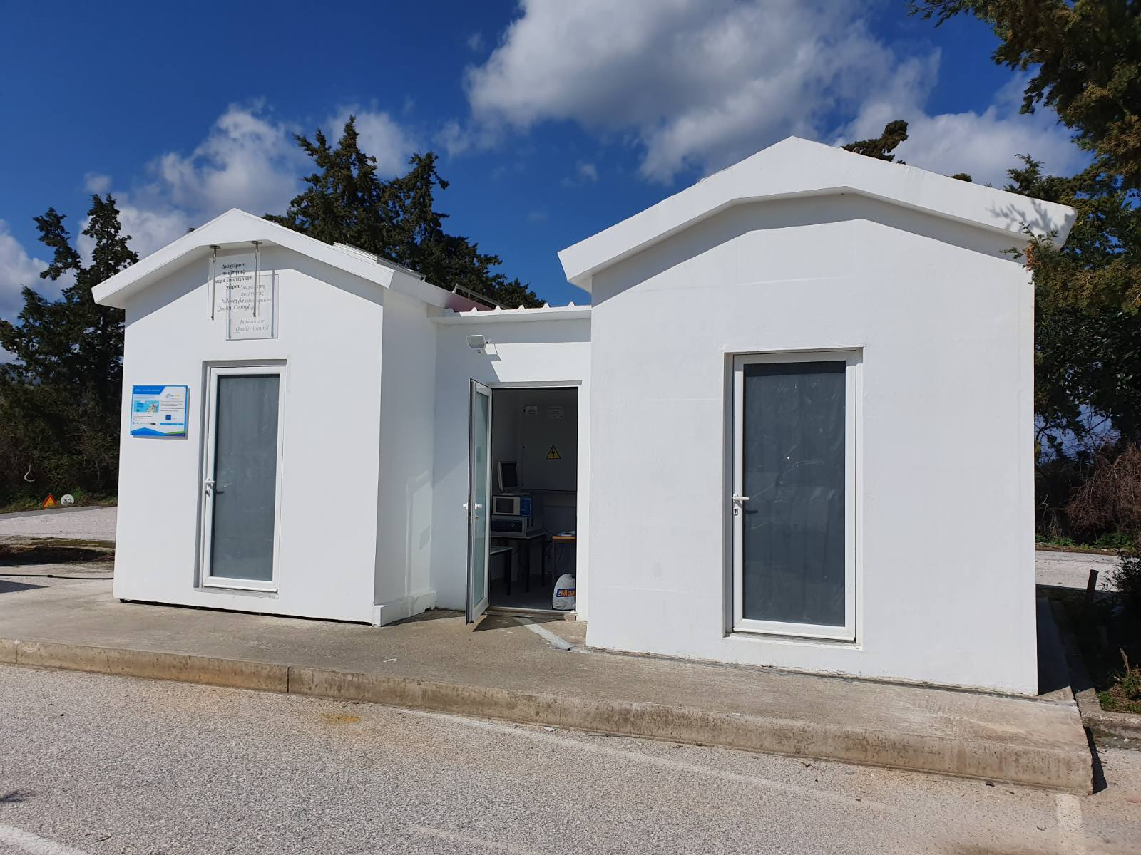
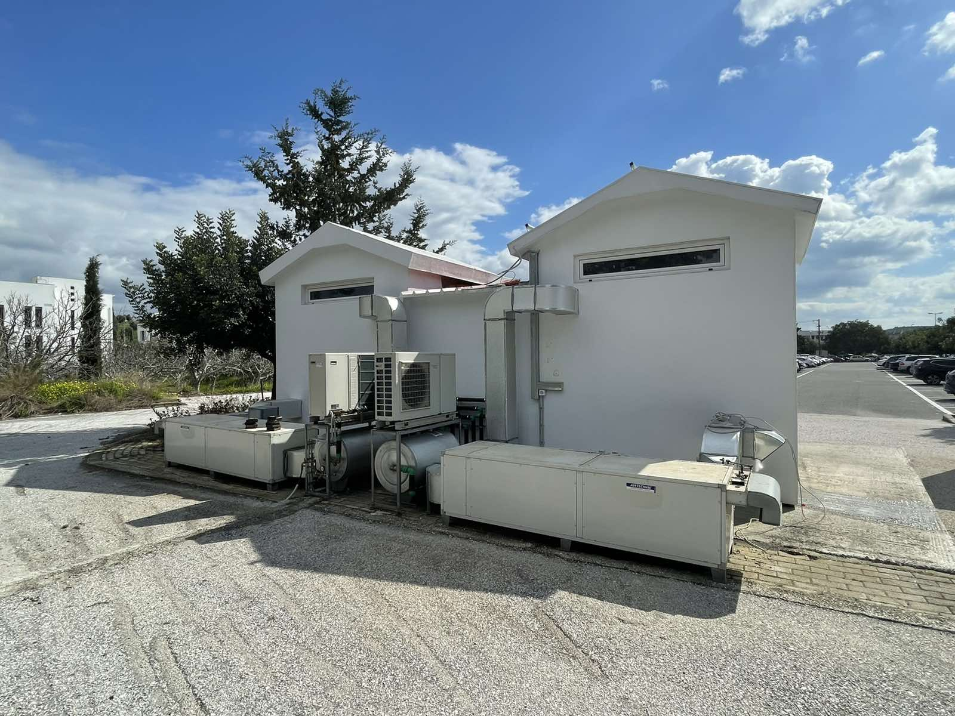
A. Simulation - Demo Houses
The project has received funding from the LIFE Programme of the European Union under GA number LIFE19 ENV/GR/000100
LIFEVISIONS
Parameters:
Mechanical ventilation (ASHRAE 62.1)
Natural ventilation
Photocatalysis
Output data:
Energy consumption
CO₂ emissions
NOx emissions
LIFE VISIONS

Slide 8
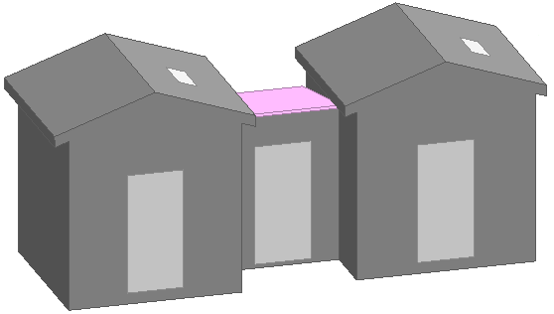
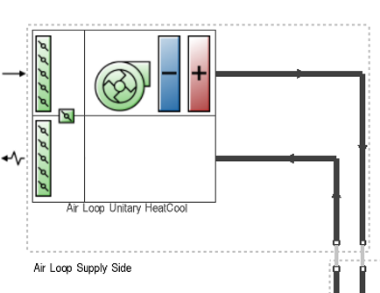
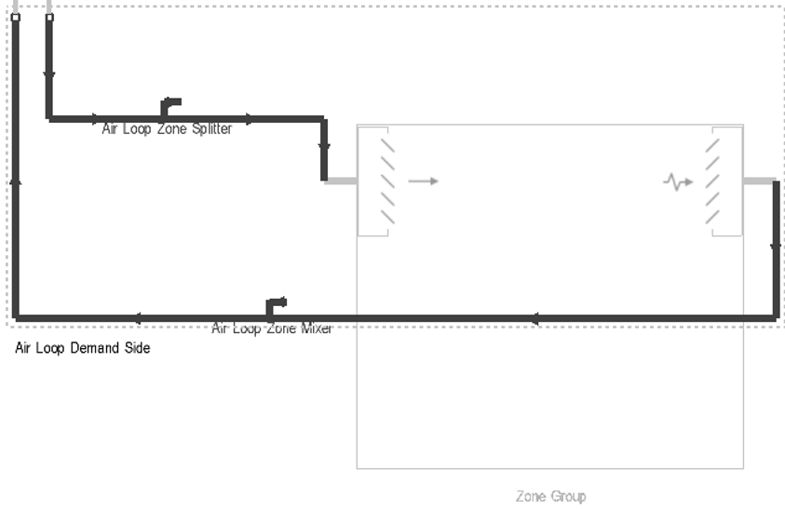
The project has received funding from the LIFE Programme of the European Union under GA number LIFE19 ENV/GR/000100
LIFEVISIONS
A. Simulation - Demo Houses
Envelope design
HVAC systems
LIFE VISIONS

Slide 9
A. Simulation scenarios - Demo Houses
The project has received funding from the LIFE Programme of the European Union under GA number LIFE19 ENV/GR/000100
LIFEVISIONS
Scenario | Scenario description | Ventilation m3/h, Air changes per hour | Concentration ΝΟ,ΝΟ2,CO2 | Pollutants reduction efficiency
Baseline | Conventional without photocatalysis and not adequate mechanical ventilation | 17.57 m3/h, 0.74 ACH | NO:27μg/m3 NO2:32μg/m3 CO2:455 ppm
1 | Photocatalysis and mechanical ventilation | 17.57 m3/h, 0.74 ACH | NO:10μg/m3 NO2:12.6μg/m3 CO2:455 ppm | NO:63% NO2:60.6%
2 | Increased mechanical ventilation in order to accomplish the same emission reduction as with photocatalysis | 151.2m3/h, 6.36 ACH | NO:10.7μg/m3 NO2:12.9μg/m3 CO2:400 ppm | NO:60.3% NO2:59.6%
3 | Maximum of natural ventilation | 72.68m3/h, 3 ACH | NO:14μg/m3 NO2:17μg/m3 CO2:447 ppm | NO:48% NO2:46.8%
4 | Night ventilation | 35.2m3/h, 1.5 ACH 7:00 p.m-17:00a.m. 151.2m3/h, 6.36 ACH | NO:15.1μg/m3 NO2:18.1μg/m3 CO2:419.4 ppm | NO:44.1% NO2:43.4%
LIFE VISIONS
18

Slide 10
A. Simulation results - Demo Houses
The project has received funding from the LIFE Programme of the European Union under GA number LIFE19 ENV/GR/000100
LIFEVISIONS
The issue is to find the scenario that can achieve the same emissions reduction as with photocatalysis with the least energy consumption in regards to ventilation.
 | Cooling Loads (kWh) | Final Energy Conspumption (kWh) | CO2 Emissions (Kg)
SC1 | 130,71 | 37,35 | 30,25
SC2 | 287,01 | 84 | 73,22
SC3 | 155,5 | 44,42 | 35,98
SC4 | 173,86 | 49,67 | 44,2
LIFE VISIONS

Slide 11
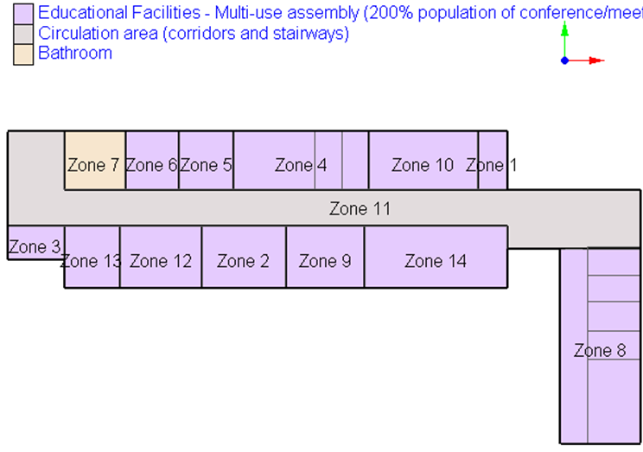
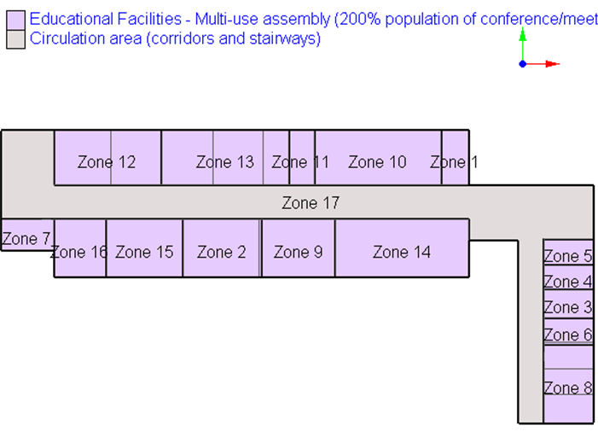
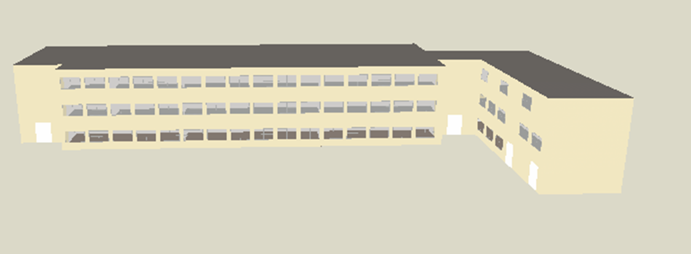
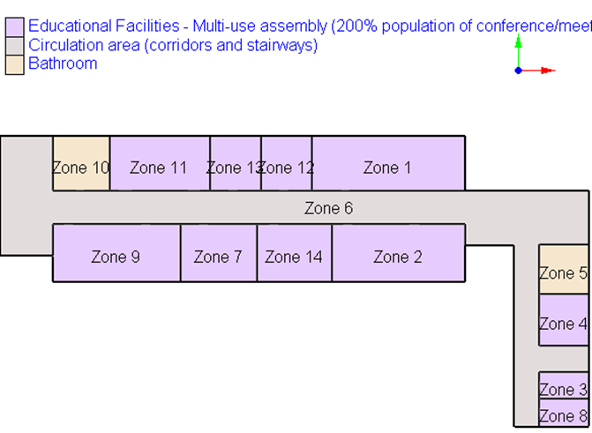
The project has received funding from the LIFE Programme of the European Union under GA number LIFE19 ENV/GR/000100
LIFEVISIONS
B. Simulation – Naval Academy
LIFE VISIONS

Slide 12
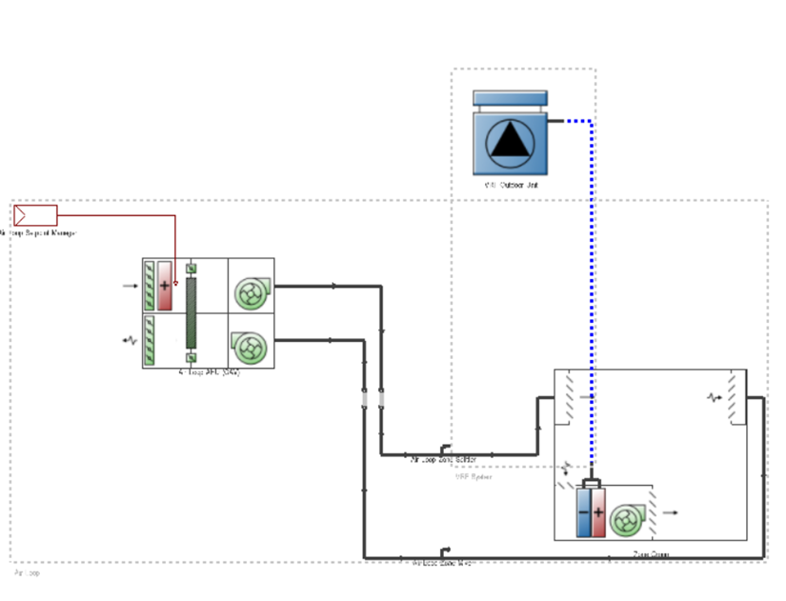
The project has received funding from the LIFE Programme of the European Union under GA number LIFE19 ENV/GR/000100
LIFEVISIONS
B. Simulation – Naval Academy
Naval academy-VRF (Variable Refrigerant Flow) system simulation
LIFE VISIONS

Slide 13
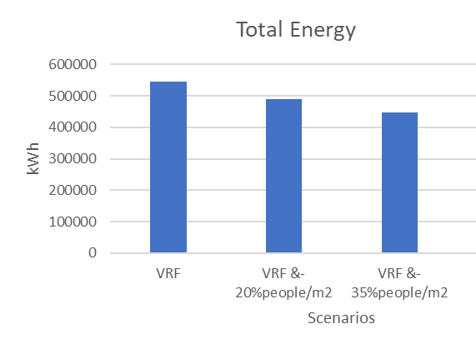
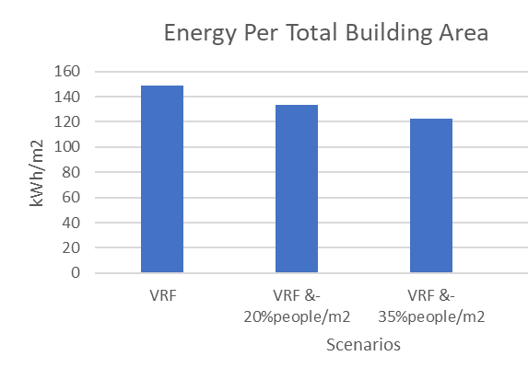
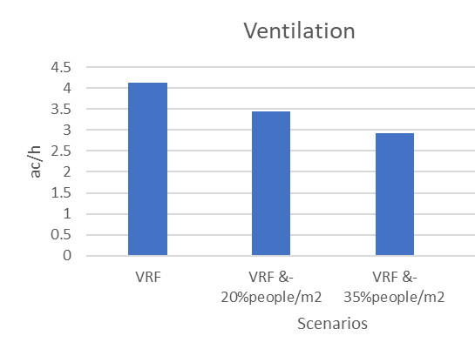
The project has received funding from the LIFE Programme of the European Union under GA number LIFE19 ENV/GR/000100
LIFEVISIONS
B. Simulation Results – Naval Academy
SC1 (without photocatalysis) the energy consumption reaches 544103.64 kWh and 236.76 kWh/m² of conditioned building area. Increased ventilation rate.
SC2 (with photocatalysis) and people density reduced by 20%.
Reduced people density – reduction to ventilation rate. Energy consumption reaches 488796.48 kWh and 212.69 kWh/m² of conditioned building area.
SC3 (with photocatalysis reduce more the people density).
Energy consumption reaches 447965.8 kWh and 194.93 kWh/m² of conditioned building area.
LIFE VISIONS

Slide 14
The project has received funding from the LIFE Programme of the European Union under GA number LIFE19 ENV/GR/000100
LIFEVISIONS
Key Results & Discussion
There is a correlation of ventilation rates and photocatalysis (ventilation is related to energy consumption).
The simulations determined significant energy consumption reduction compared to the conventional scenario (without photocatalysis) because of the ventilation rate reduction (given as a fact that we want specific ventilation rate to reduce pollutants concentration).
The results in real scale application showed a correlation of ventilation rates and photocatalysis (ventilation is related to energy consumption). The simulations determined about 11 – 22% energy reduction compared to the conventional scenario (without photocatalysis) because of the ventilation rate reduction. The ventilation rate was determined by the occupancy in the photocatalytic scenarios.
LIFE VISIONS

Slide 15
The project has received funding from the LIFE Programme of the European Union under GA number LIFE19 ENV/GR/000100
LIFEVISIONS
THANK YOU!
https://lifevisions.gr/
LIFE VISIONS

